Slide 1


Assignment 1

Slide 2
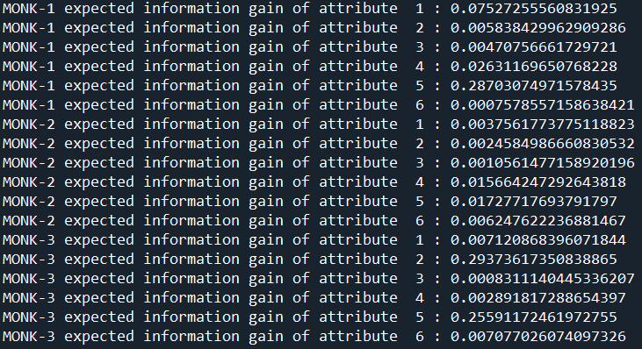

Assignment 3

Slide 3
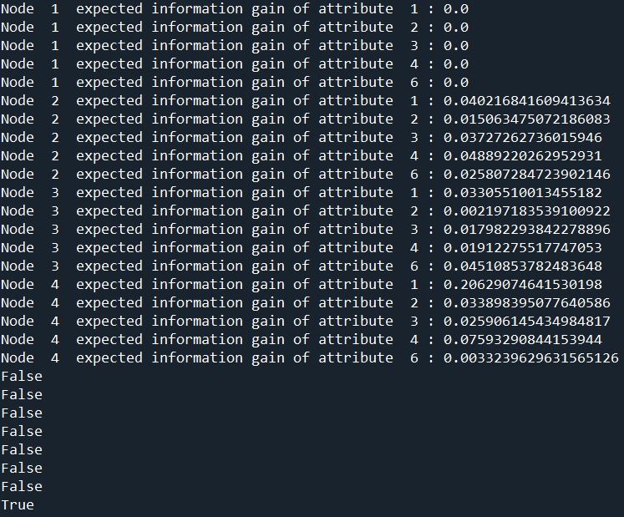
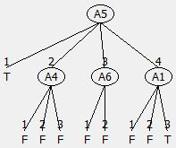
Pre-assignment 5

Slide 4

Assignment 5
MONK-1 tree

Slide 5

Assignment 5
MONK-2 tree

Slide 6
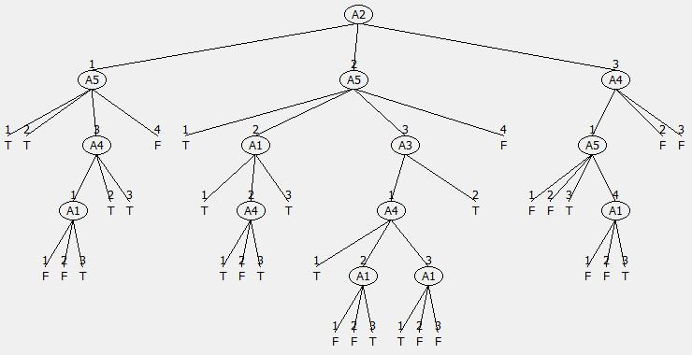
Assignment 5
MONK-3 tree

Slide 7


Assignment 5

Slide 8
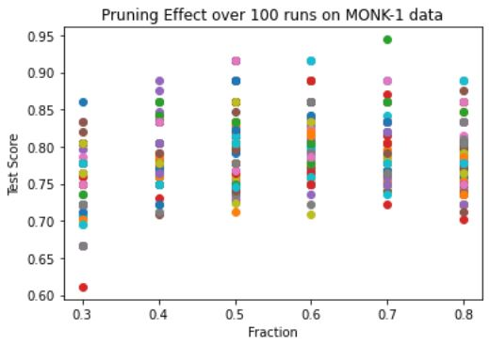

Assignment 7
MONK-1 data

Slide 9
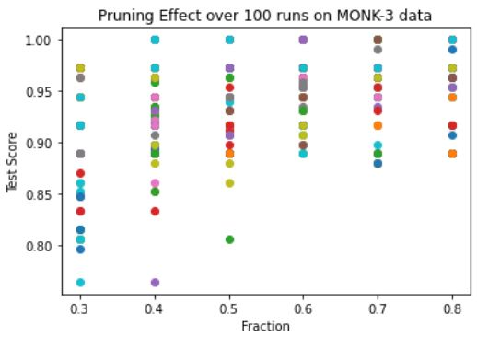

Assignment 7
MONK-3 data

